Slide 1
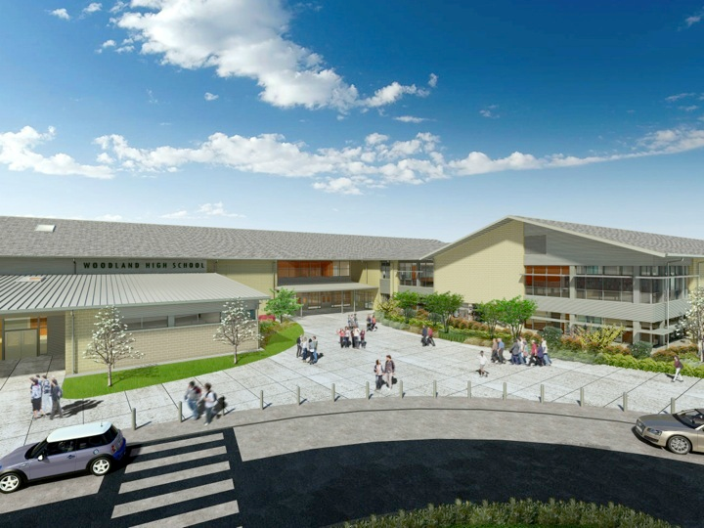
Woodland Public Schools
Facilities & Safety Report
2025

Slide 2
Facilities/Safety Report
A new portable is being purchased and the permitting process has been started for an additional portable at North Fork Elementary.
The grounds crew is transitioning from sports fields to leaf and storm water management. For Nov.-Dec. they will concentrate on site cleaning, pressure washing, and preventative maintenance for grounds equipment.
Maintenance has been working on system repairs, work orders and buttoning up our stadiums for the winter. We’ll be working on gutter cleaning and rooftop maintenance until all the leaves have fallen.
The north wall of the green gym at Woodland Middle School will be cleaned and re-sealed (weather permitting) following a leaking drain pipe being repaired.
Facilities is working with the Business Office to pursue a couple of grant opportunities in hopes of funding some roofing as well as the fire alarm system at Woodland Middle School.
Facilities is supplying and planning for inclement weather days. We will be on early shifts on days with snow or ice to prepare for staff and student arrivals.

Slide 3
Facilities/Safety Report
I attended a multi-agency exercise hosted by PacifiCorp to plan for the possibility of dam failures on the Lewis River. This was an opportunity to network with some important agencies in our area and advocate for prioritizing schools during emergencies. I met briefly with the Emergency Manager of the Cowlitz Tribe and began a discussion about emergency planning collaboration.
Our dayshift custodian at Woodland High School is retiring after 30 years of service to Woodland Public Schools as a para and as a custodian. If you have the chance be sure to say thanks and best wishes to Camille Wilson.

